Slide 1
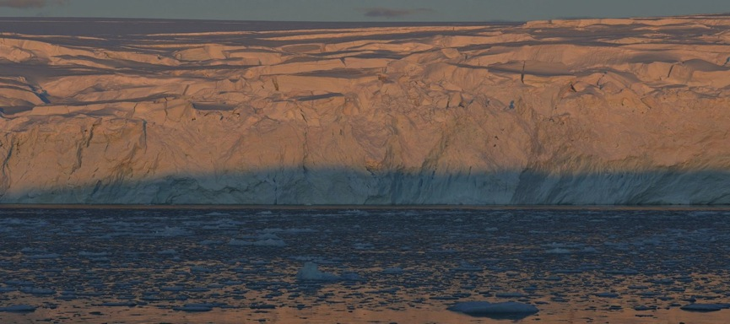


An Assessment of the Net Summertime Drawdown of Atmospheric Carbon Dioxide by the Southern Ocean
Jack Johnson
Dept of Geosciences, University of Arizona
Collaborators: Prof. Joellen Russell, Dr. Paul Goodman
NASA symposium Spring 2016

Slide 2
Objectives
1
To derive pH and total alkalinity in seawater from Southern Ocean float data
2
To calculate DIC in order to roughly quantify Atmospheric Carbon Dioxide Drawdown by the Southern Ocean
3
To Define the Seasonal cycle for carbon Dioxide in the Southern Hemisphere

Slide 3
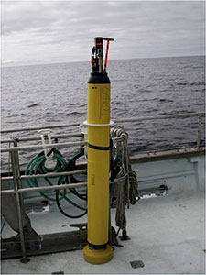
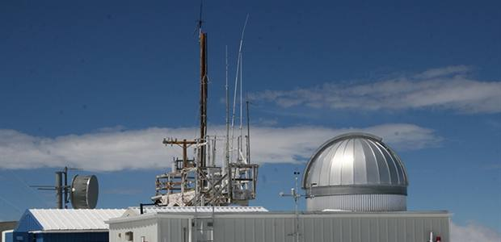
Data Collection
Surface Flask
Southern Ocean Floats
CO₂
CH₄
CO
N₂O
¹³C/¹²C (CO₂)
Temperature
Salinity
Oxygen
Nitrate
pH(very few)
esrl.noaa.gov
soccom.princeton.edu
Notes:
C12 preferentially taken up by plants
Ocean floats dive to 2000m, sit for a few days, come back up and every 5-10m they take a measurement of all of the things stated above.

Slide 4
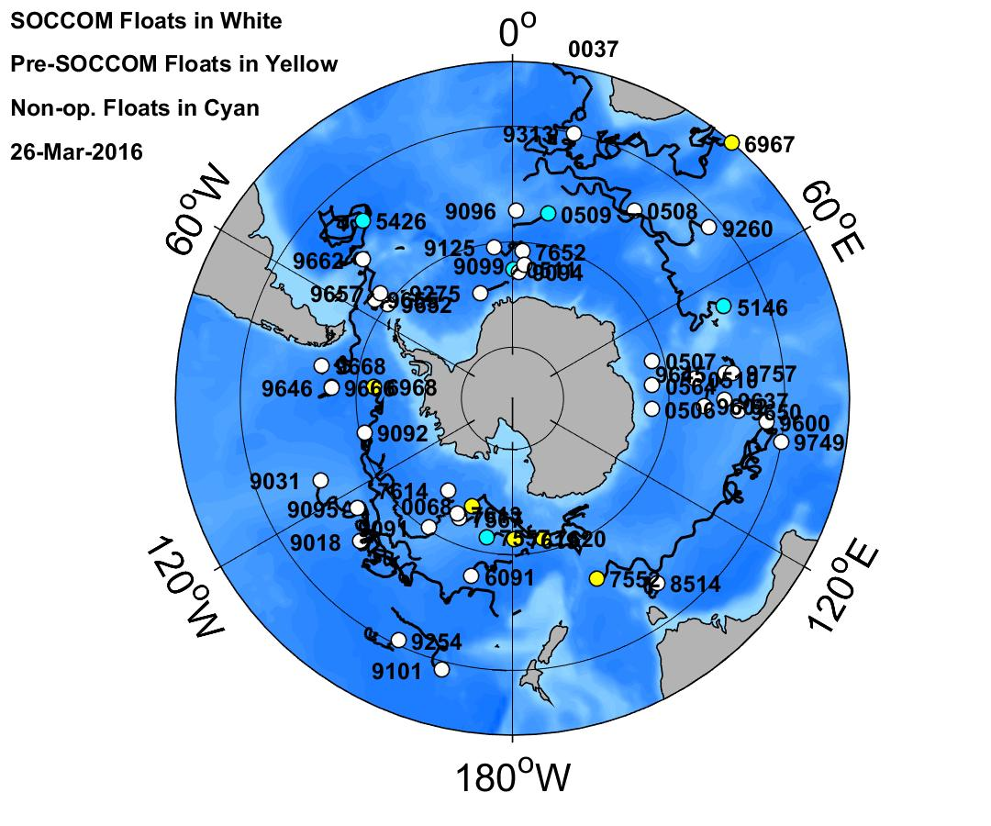
Southern Ocean Float Locations
soccom.princeton.edu

Slide 5
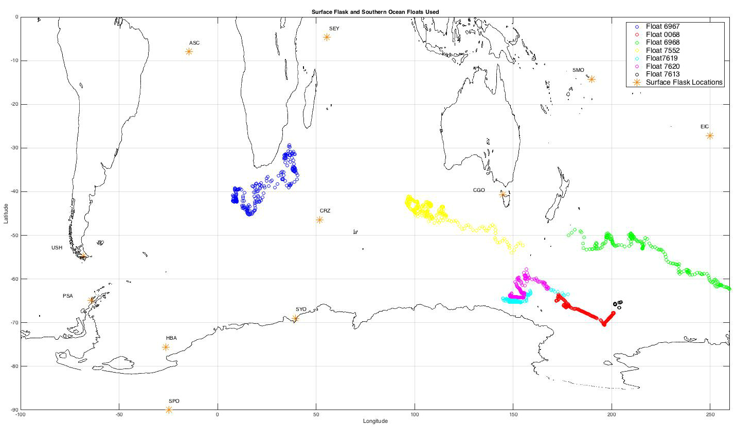
Southern Ocean Floats and SH Surface Flask Stations Used
Latitude
Longitude
Notes:
The surface flask stations monitor carbon dioxide directly, however, it is much more tricky with ocean carbon dioxide.

Slide 6
Ocean CO₂
Is a function of pH and alkalinity
  given any two: pH, alk, DIC, or pCO₂
  You can calculate the other two
However, our traditional ocean floats don’t collect any of the four directly

Slide 7
Applying the alkalinity and pH algorithms
SSS = sea surface salinity
SST = sea surface temperature
This means we can get total alkalinity!
Total alkalinity =
Lee et al. 2006

Slide 8

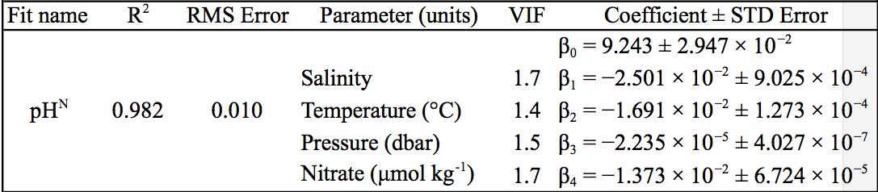
Applying the alkalinity and pH algorithms
Williams et al. 2016

Slide 9
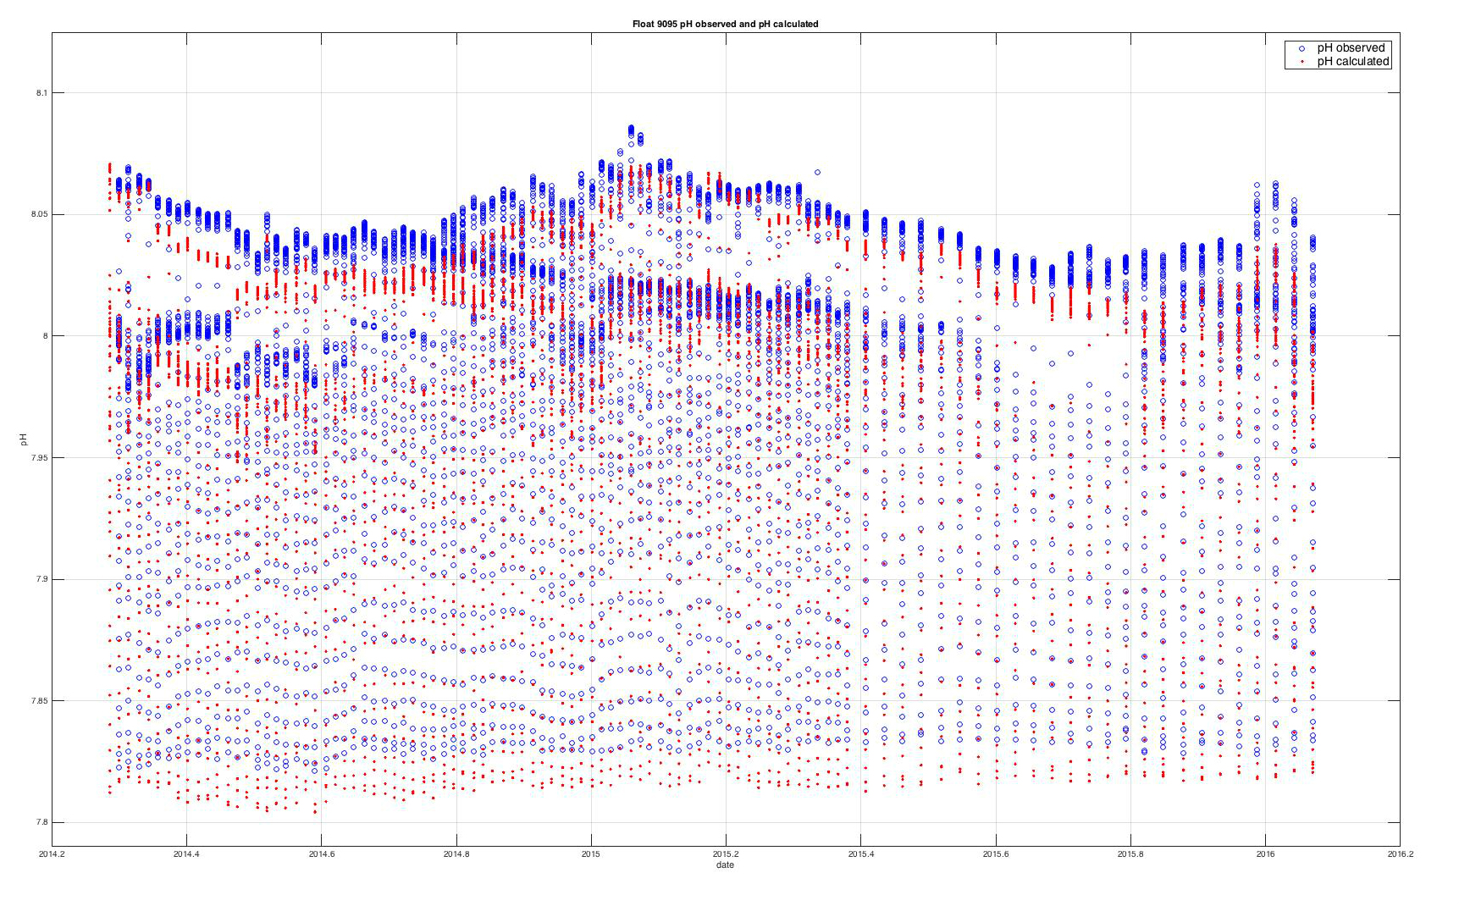
pH measured versus pH calculated
pH
Date

Slide 10
pH measured versus pH calculated
Off by .24%
pH
Date

Slide 11
Now we have both pH and Alk
  Which means we can calculate ocean DIC
  For this we used CO2sysv1.1.m (matlab)

Slide 12
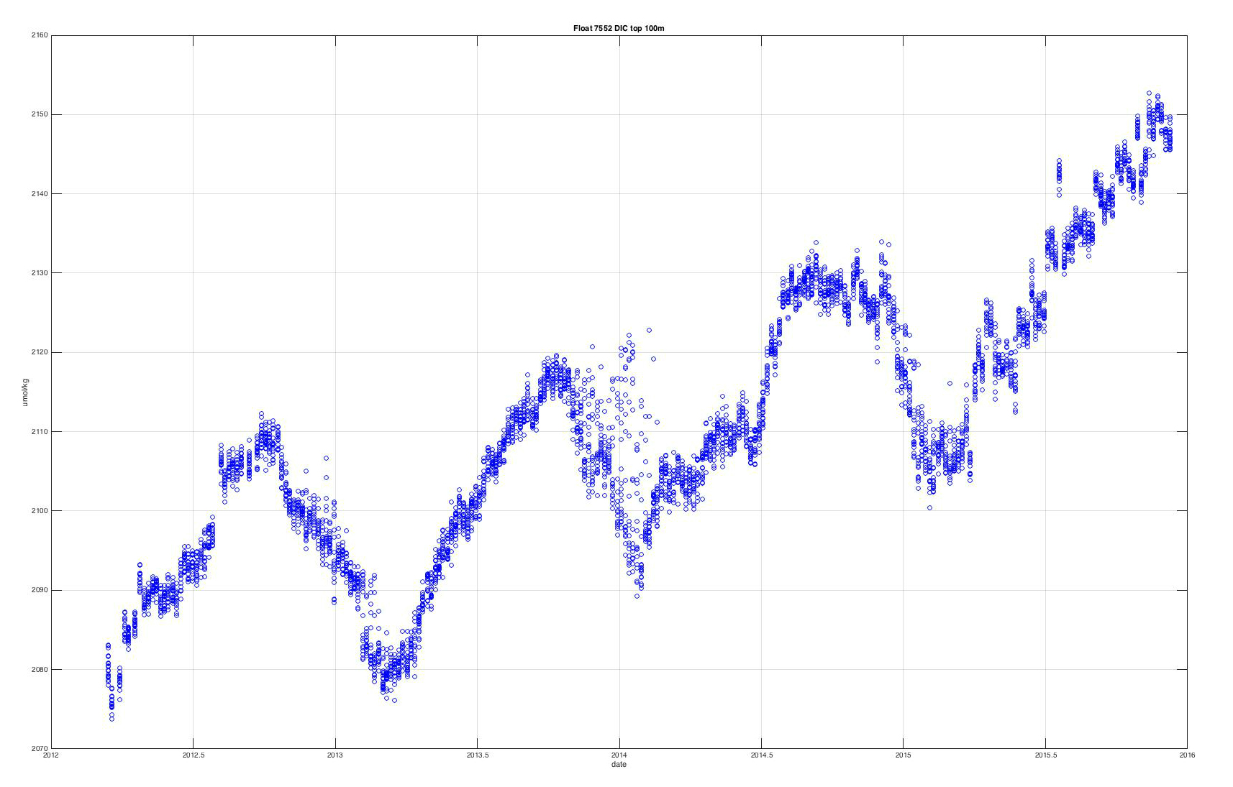
DIC Example Float 7552
DIC (umol/kg)
Date

Slide 13
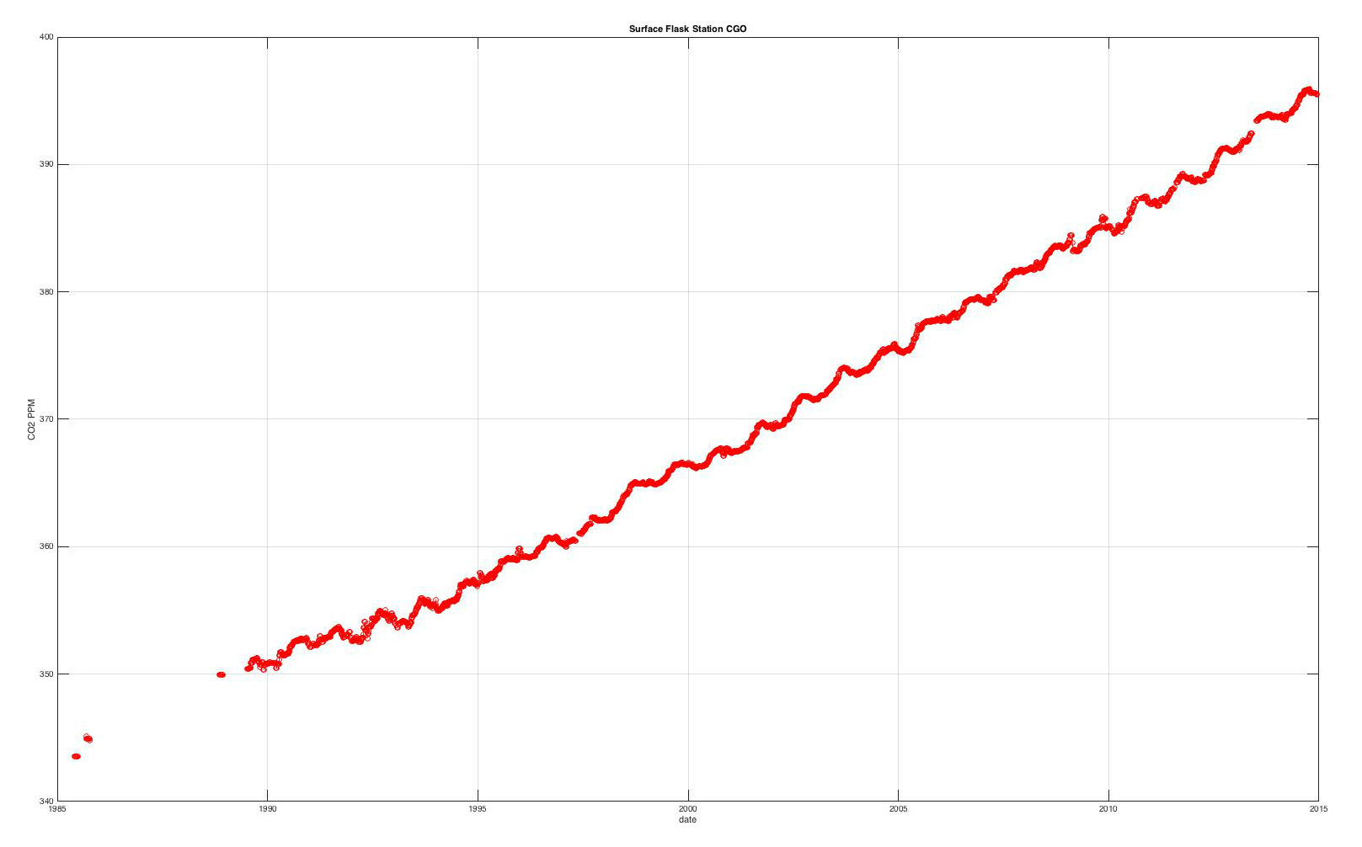
Surface Flask Example (CGO)
CO₂ (ppm)
Date

Slide 14
Southern Ocean Floats Used
Station CGO
Float 7552

Slide 15
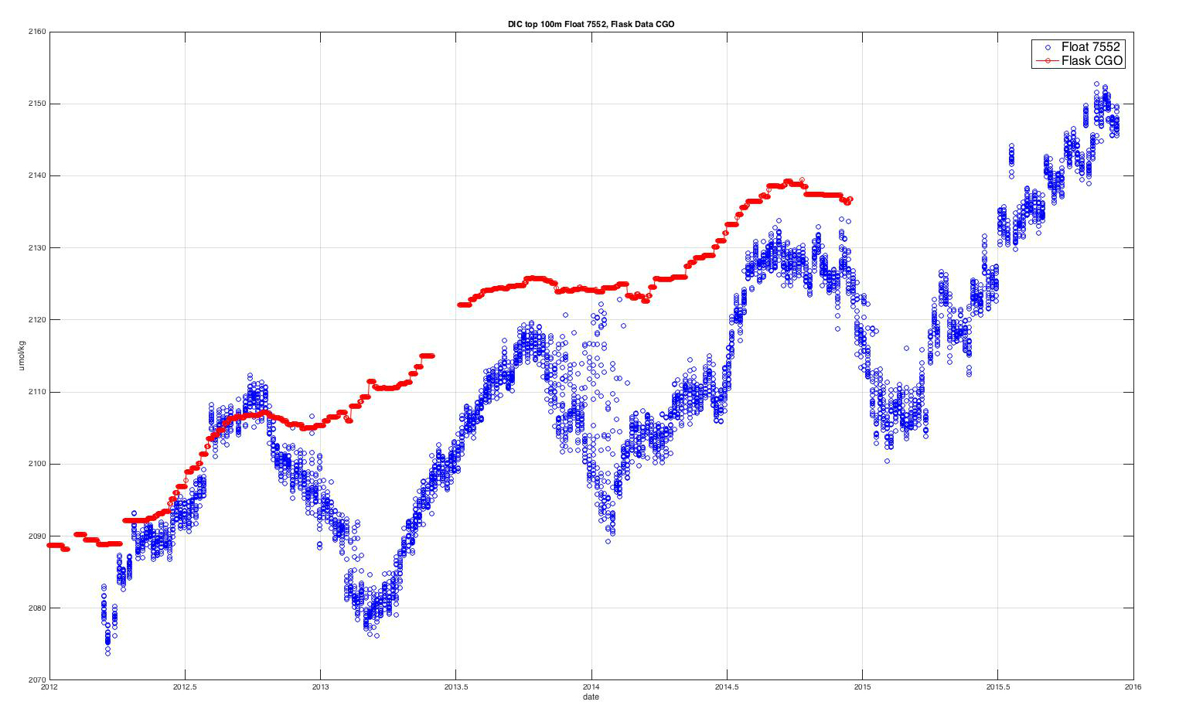
Ocean Float DIC and Surface Flask CO2
398
397
396
395
CO₂ (ppm)
394
DIC (umol/kg)
CO2 (ppm)
DIC (umol/kg)
393
392
391
390
389
winter
winter
Date
winter
winter
Notes:
1st order mode: trend
2nd order mode: Seasonal Winds are more intense in the winter months = greater upwelling and gas exchange to atmo. + additional CO2 from humans. Drawdown is peak to following trough. Human CO2 input is peak to peak increase.
3rd order mode: El Nino Rough drawdown by ocean in this location = .5 ppm per year. Anthropogenic input to this location = 2 ppm
4th order mode: Volcanoes

Slide 16
Where to Next?
Currently there are 47 working floats
We need ~600 throughout all ocean basins to reduce our error to 1.0 GT CO₂/yr
M. Mazloff
Notes:
~ 600 floats throughout all ocean basins at 334 km spacing
Each dark blue dot is a float. Current error 1.8

Slide 17
In Conclusion
We can define the seasonal cycle through SH atmosphere and Southern Ocean data
Roughly quantify the ocean drawdown and anthropogenic CO₂ input
Proof you can derive ocean CO₂ from float data
Provides an excellent small scale model for a global float network

Slide 18
Thank You

